Slide 1

Intro to Descriptive Statistics
By: Mahmoud Galal

Slide 2
AGENDA
01
02
03
04
Recap
Measures of Spread
Measures of shape and Visuals
Exploratory Data Analysis

Slide 3
Recap

Slide 4
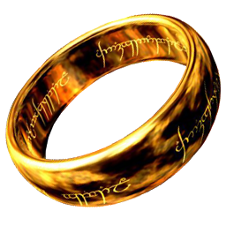
Summary Statistics
“ONE NUMBER TO RULE THEM ALL ,
ONE NUMBER TO FIND THEM ALL ,
ONE NUMBER TO BRING THEM ALL ”
-Gandalf The Grey

Slide 5
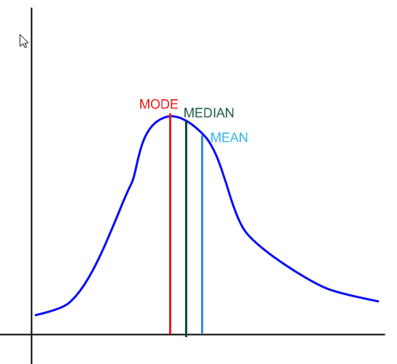
Measures of location (Central Tendency)
It’s the measures that describes the central value of a data set, And Its most popular forms are:
Mean
Median
Mode
Frequency(X)
X
Reference

Slide 6
Summary statistics types
A sample summary is a Statistic, A population summary is a Parameter.
We can summarize our data with different measures. Each of them adds a certain power to the analysis.
Measures of location (Mean, Median, mode)
Measures of spread (Min, Max, Variance and Standard Deviation)
Measures of shape (Skewness and Kurtosis)

Slide 7
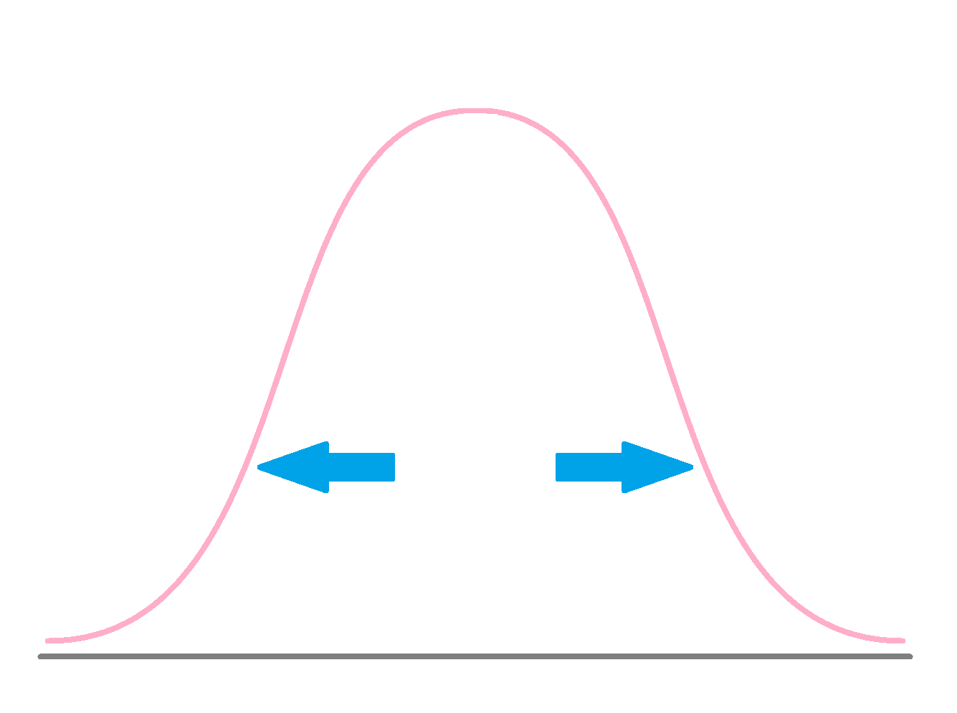
Measures of Spread
Describe how dispersed or varied data is. We can see measures of spread in these forms:
Ranges (Maximum - Minimum)
IQR
Variance
Standard Deviations

Slide 8
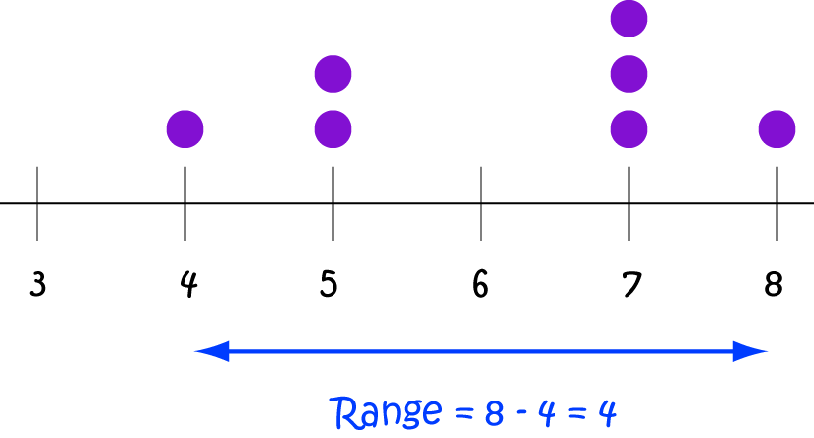
Ranges
The range is the simplest measure of variability to compute, It’s simply the difference between the Maximum Value and the minimum.
It provides a simple view of how varied our data set is.
The range can also be used to estimate the standard deviation (The Range Rule).
It’s highly sensitive to outliers.
The range also tells us nothing about the internal features of our data set.

Slide 9
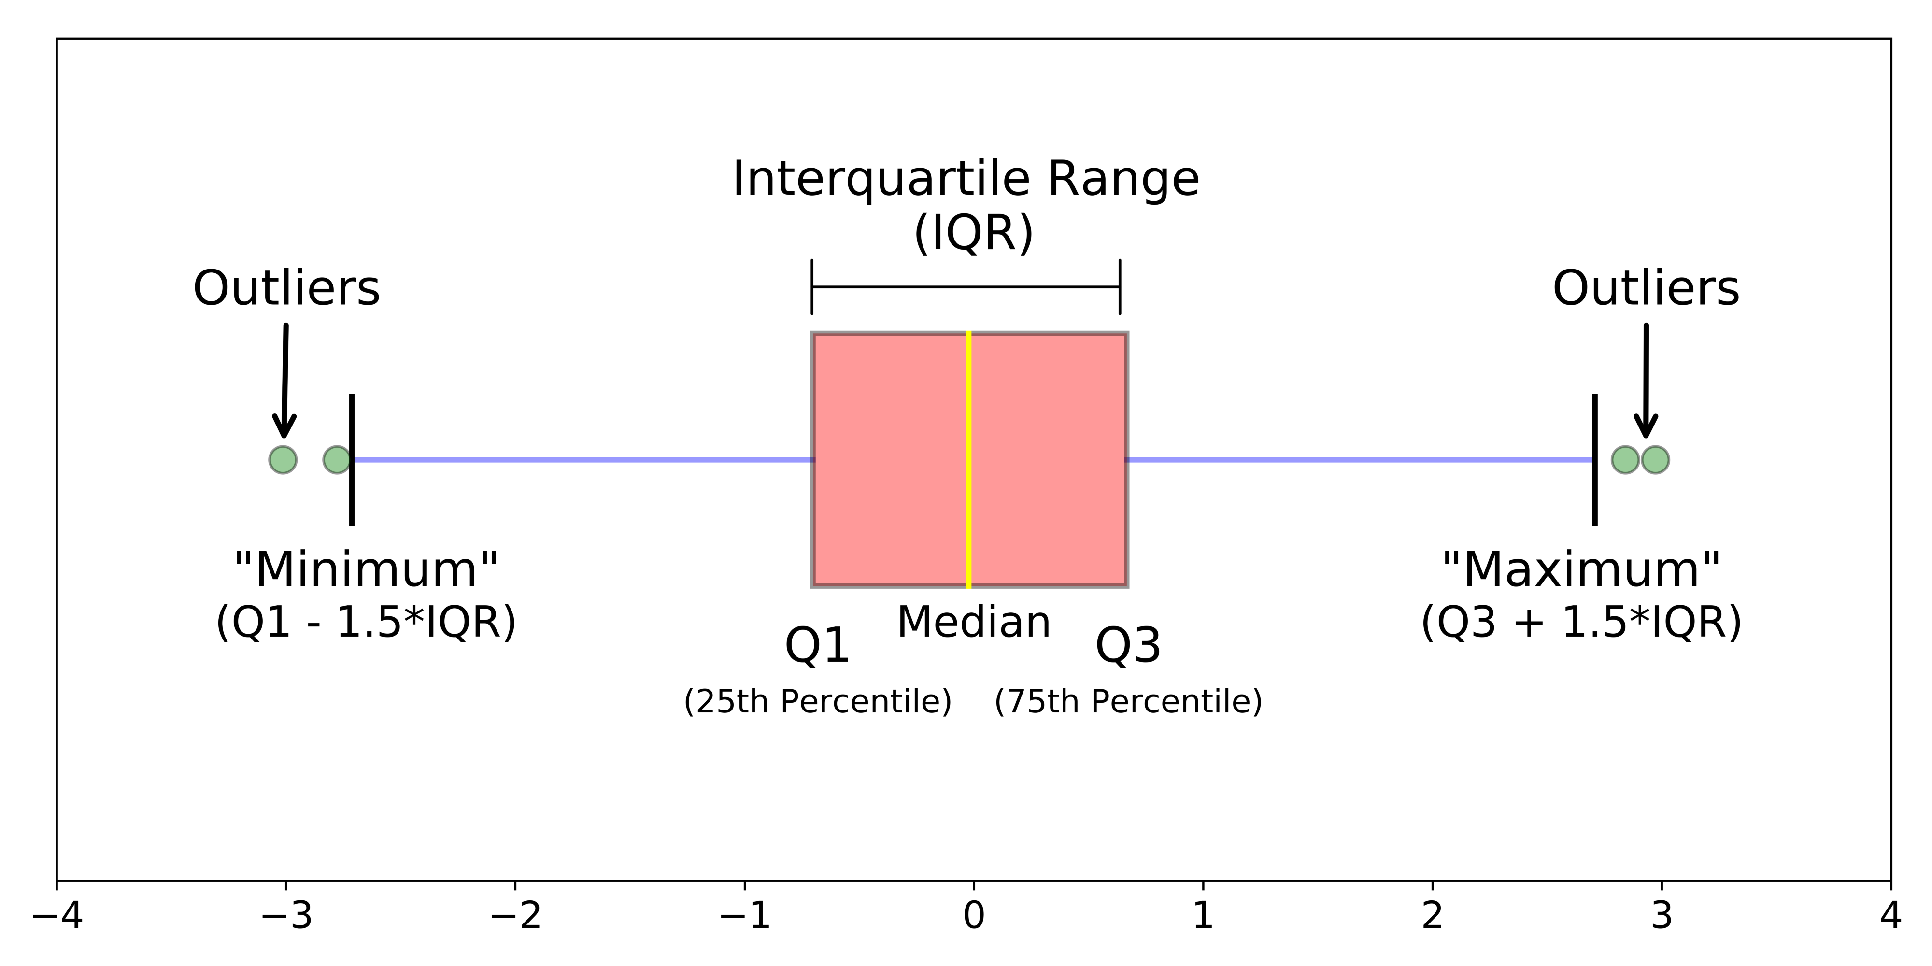
The Interquartile range
We can use the box-plot and the IQR value to represent the variability.
Remember that IQR = Q3 – Q1
The problem is that IQR doesn’t represent the whole dataset (Just 50% of it), so it won’t be an accurate representation of the dataset's variability.
It also doesn’t tell us nothing about the internal features of our data set just like the Range.
We need to include all of our data sets in the computation … How ?

Slide 10
Measuring variability using all data points
Ranges doesn’t give the full picture, so we have to use all of our data points’ values to represent the dataset variability. We can think of multiple ways.
Find the average distance between any two value.
It’s inefficient due to the big amount values
Find the average between every minimum and maximum value.
It’s inefficient due to the lack of standardization.
Find the average distance between every value and the mean value.
And that is the most effective way.

Slide 11
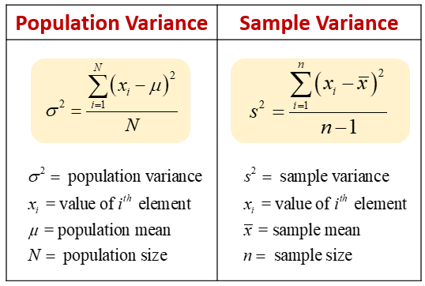
Variance
Variance (σ²) a measurement of the spread between each number and the average numbers in the dataset.
To calculate the population variance (σ²), we take the sum of distances between each data point and the population mean divided by the total number of data points.
In case of sample variance, there is a tiny difference. That we divide by the total number of data points in the sample – 1 (n-1). And that is called Bessel’s Correction.
This correction is made to correct for the fact that these sample statistics tend to underestimate the actual parameters found in the population.

Slide 12
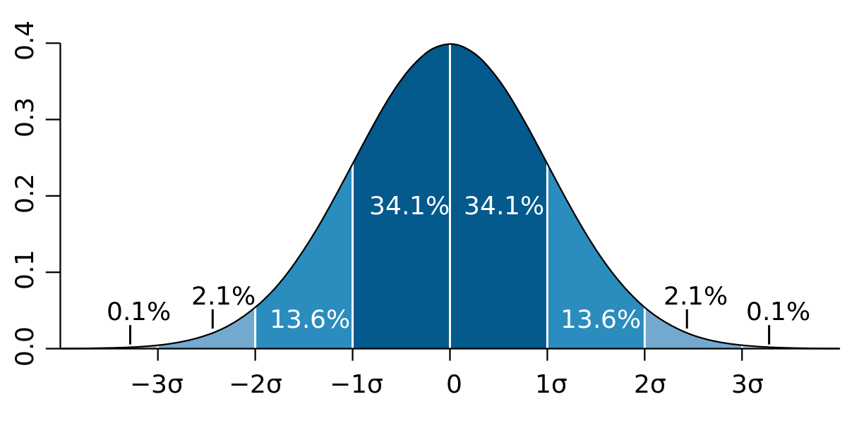
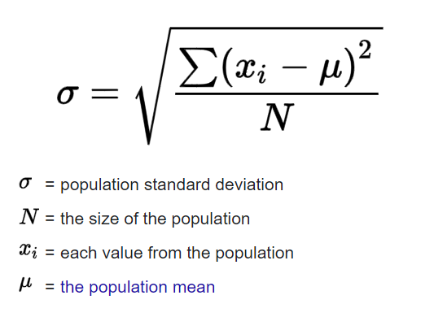
Standard Deviation
Standard Deviation (σ) is the most common measure of spread for its robustness and unified measurements.
It’s the same calculations of the Variance except we take the squared root of the variance output.
In a standardized distribution, we found that:
68% of data lies in 1σ from the mean.
95% lies in 2σ from the mean.
So with standard deviation we can know how much data falls in one area. And that helps us making our assumptions and tests.

Slide 13
Statistics Summary
$28
$ 50
$452
$33
The middle price (Median)
Avg. price (Mean)
Most Frequent Price (Mode)
$7
Standard Deviation
Maximum price

Slide 14
5-Min Break
Please submit your attendance while
Making yourself something hot

Slide 15
Measures of Shape

Slide 16
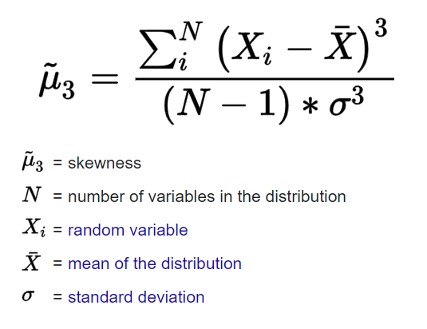
Skewness
Skewness refers to distortion or asymmetry in a symmetrical bell curve, or normal distribution, in a dataset.
A symmetrical distribution will have a skewness of 0.
If skewness is positive, the data is left-skewed , meaning that the right tail of the distribution is longer than the left.
If skewness is negative, the data are negatively skewed or right-skewed, meaning that the left tail is longer
In negative skewness, the value of the skewness is < 0.
In positive skewness, the value of the skewness is > 0.

Slide 17
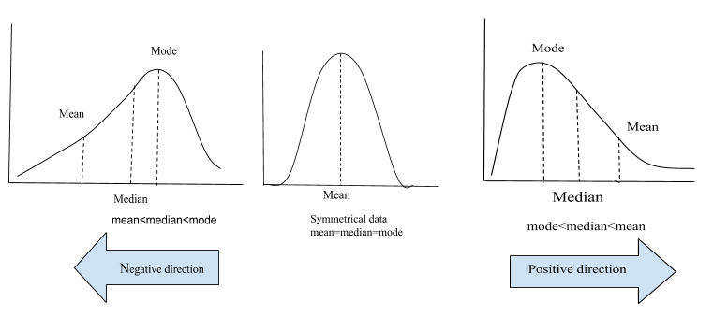
Skewness

Slide 18
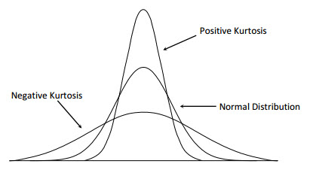
Kurtosis
Kurtosis is a statistical measure used to describe the degree to which scores cluster in the tails or the peak of a frequency distribution.
Low kurtosis is an indicator that data has light tails or lack of outliers. It’s called (PlatyKurtic)
Datasets with high kurtosis tend to have heavy tails, and it indicates to outliers. It’s called (LeptoKurtic)
It’s closely related to skewness as both represents measures of distribution shapes.
Read More

Slide 19
The power of Visualization

Slide 20
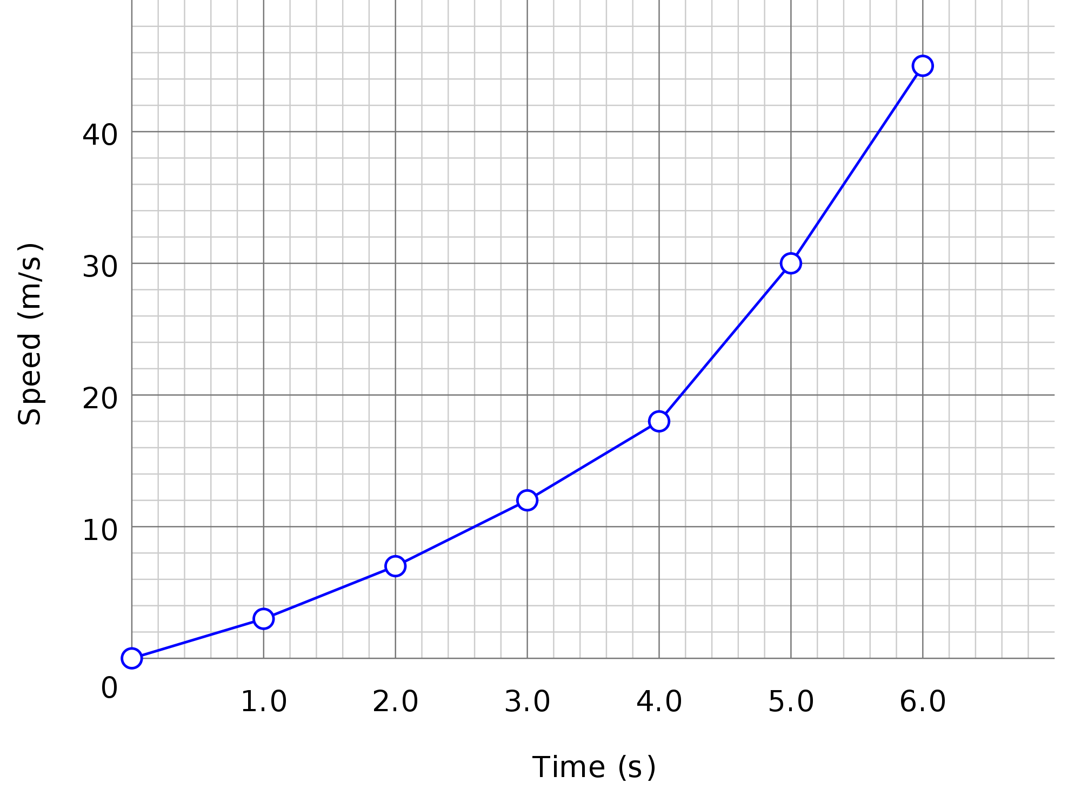
Line Plot
A line plot is a graph that shows the frequency of data occurring along a number line (Usually a timeline).
Line graphs are used to track changes over short and long periods of time.
Line graphs can also be used to compare changes over the same period of time for more than one group.
It’s very easy to interpret and use.

Slide 21
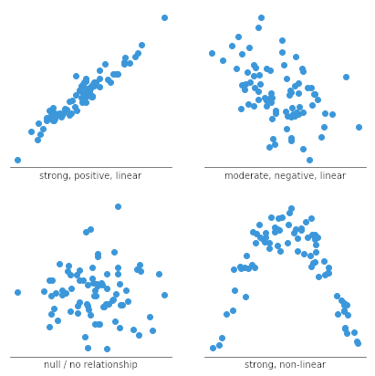
Scatter Plot
Scatter Plot is a type of plot or mathematical diagram using Cartesian coordinates to display values for typically two variables for a set of data.
Scatter plots are used to plot data points on a horizontal and a vertical axis in the attempt to show how much one variable is affected by another. (Correlation test)
There are many types of correlation relationships that scatter plots can reveal.

Slide 22
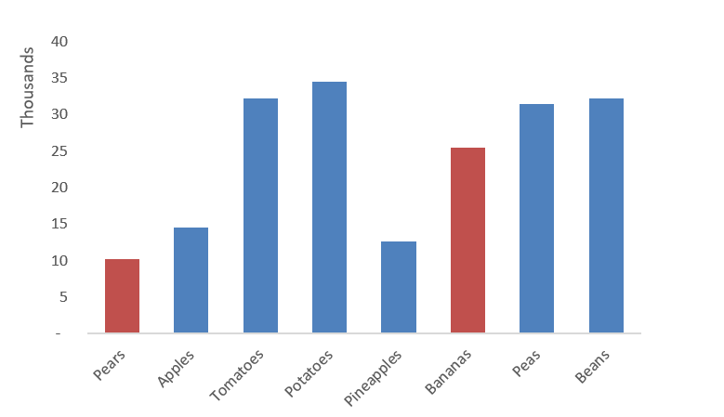
Bar Chart
A bar chart or bar graph is a chart or graph that presents categorical data with rectangular bars.
Bar graphs are used to compare things between different groups or to track changes over time.
When trying to measure change over time, bar graphs are best when the changes are larger. But line plots are more suitable for visualizing changes over time.
It can be graphed horizontally or vertically.

Slide 23
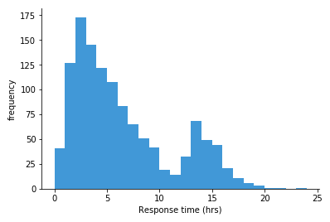
Histogram
Histograms are the most frequently used chart in frequency distribution.
Frequency distribution shows how often each different value in a set of data occurs.
Taller bars show that more data falls in that range.
A histogram displays the shape and spread of continuous sample data.

Slide 24
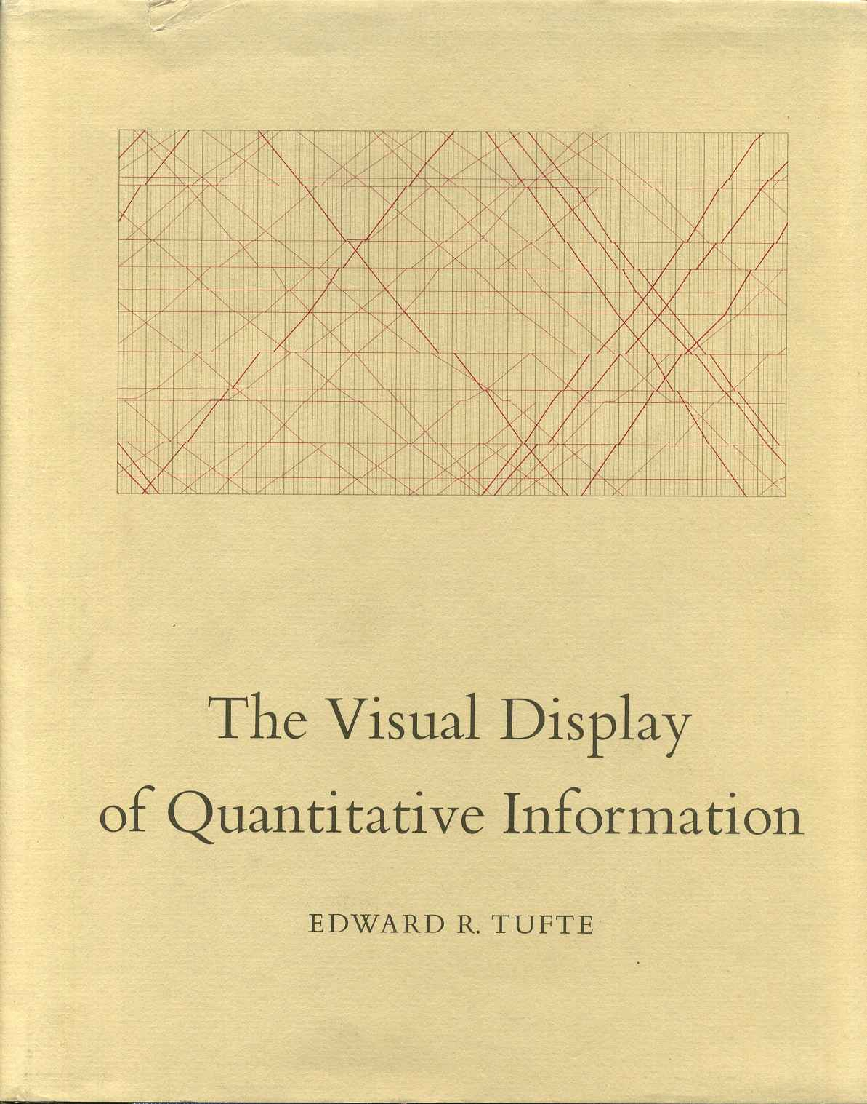
Further Reading

Slide 25
Real-World EDA

Slide 26
CONCLUSION
To summarize our lecture we can say:
Ranges and IQRs aren’t the best for reporting variability.
Variance is less used than Standard Deviation.
Summary statistics is a must when working with data.
Measures of shape help us determine what transformation and operation should we apply on the data.
Without visualization we are blind warriors with swords in a battlefield.
Every Visual has its power. Choosing when to use it and with type of data activates that power.

Slide 27
THANKS
Any Questions? …
Head to google meet !

